Slide 1
Analyzing Social Media Addiction Among Students
By: Cooper, Abdullah, Patrick, David, Alyssa

Slide 2
Big Picture
Social media is deeply integrated into student life.
It’s used for communication, entertainment, schoolwork, and networking.
But concerns exist about:
Mental health
Academic performance
Sleep
Addictive patterns

Slide 3
Why This Matters?
Pew Research (2024) found that 96% of teens use social media daily, and nearly 50% describe themselves as “almost constantly” online.
Source:https://www.pewresearch.org/internet/2024/12/12/teens-social-media-and-technology-2024/?gad_source=1&gad_campaignid=22378837192&gbraid=0AAAAA-ddO9H3s3tPiu2YKtw0lCvxNKWU6&gclid=Cj0KCQiA0KrJBhCOARIsAGIy9wD4z6GH6s7ScrVWBeyEvH4oDyJ2ZVeevzTLr0UC1X7dUxwv2KCGmosaAmKTEALw_wcB

Slide 4
Our Purpose
We wanted to understand how much students actually use social media, and whether high usage connects to addiction, sleep, or other effects

Slide 5
Our Research Questions
How many hours per day do students spend online?
What are the most used social media platforms?
Do students show signs of social media addiction?

Slide 6
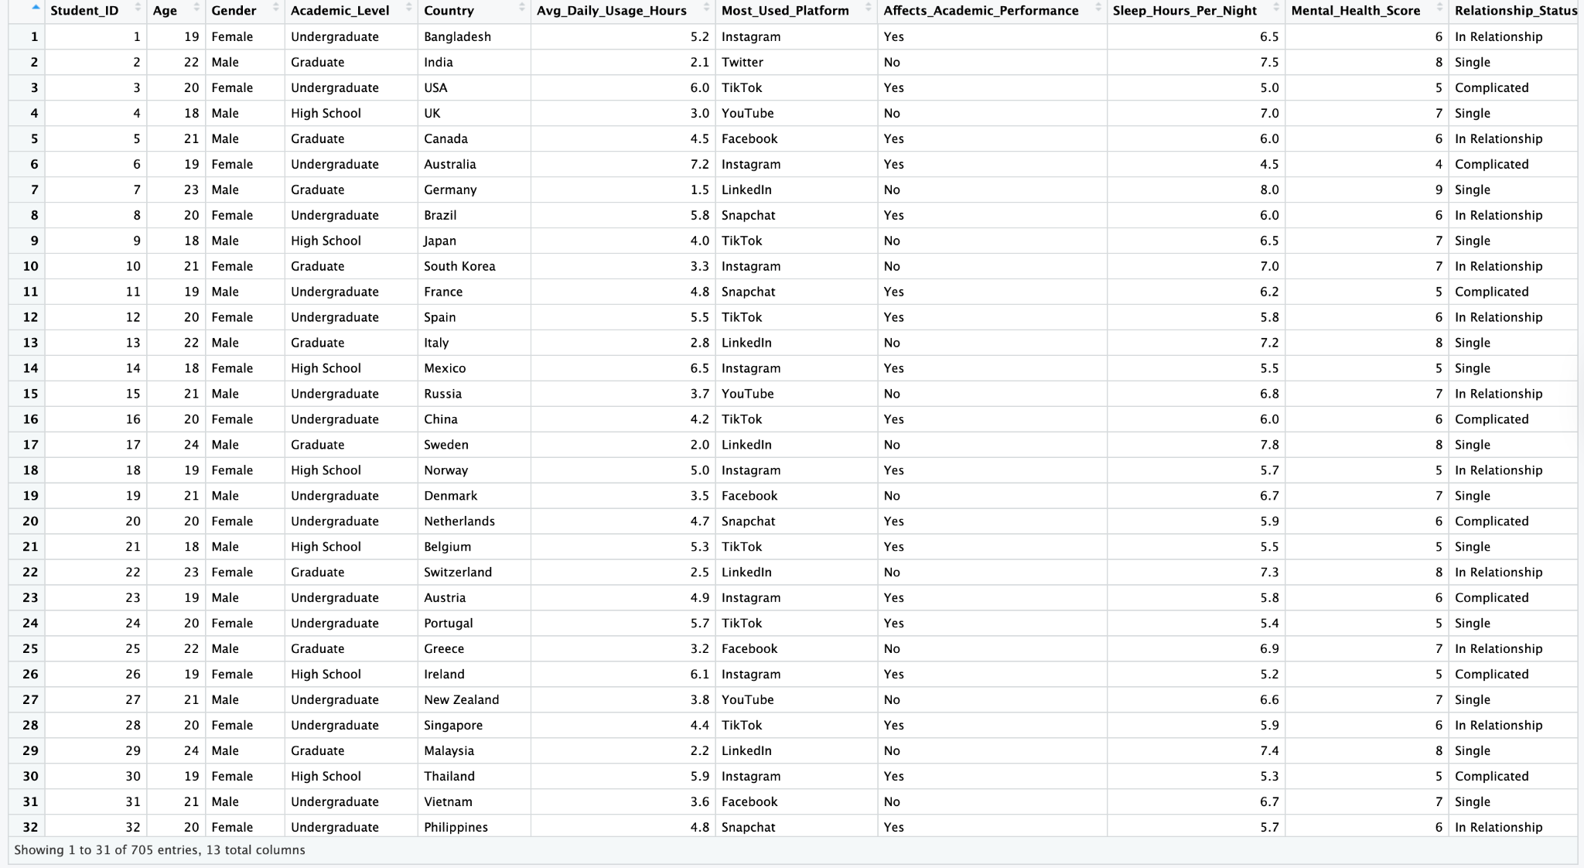
Dataset1: Students Social Media Addiction.csv

Slide 7
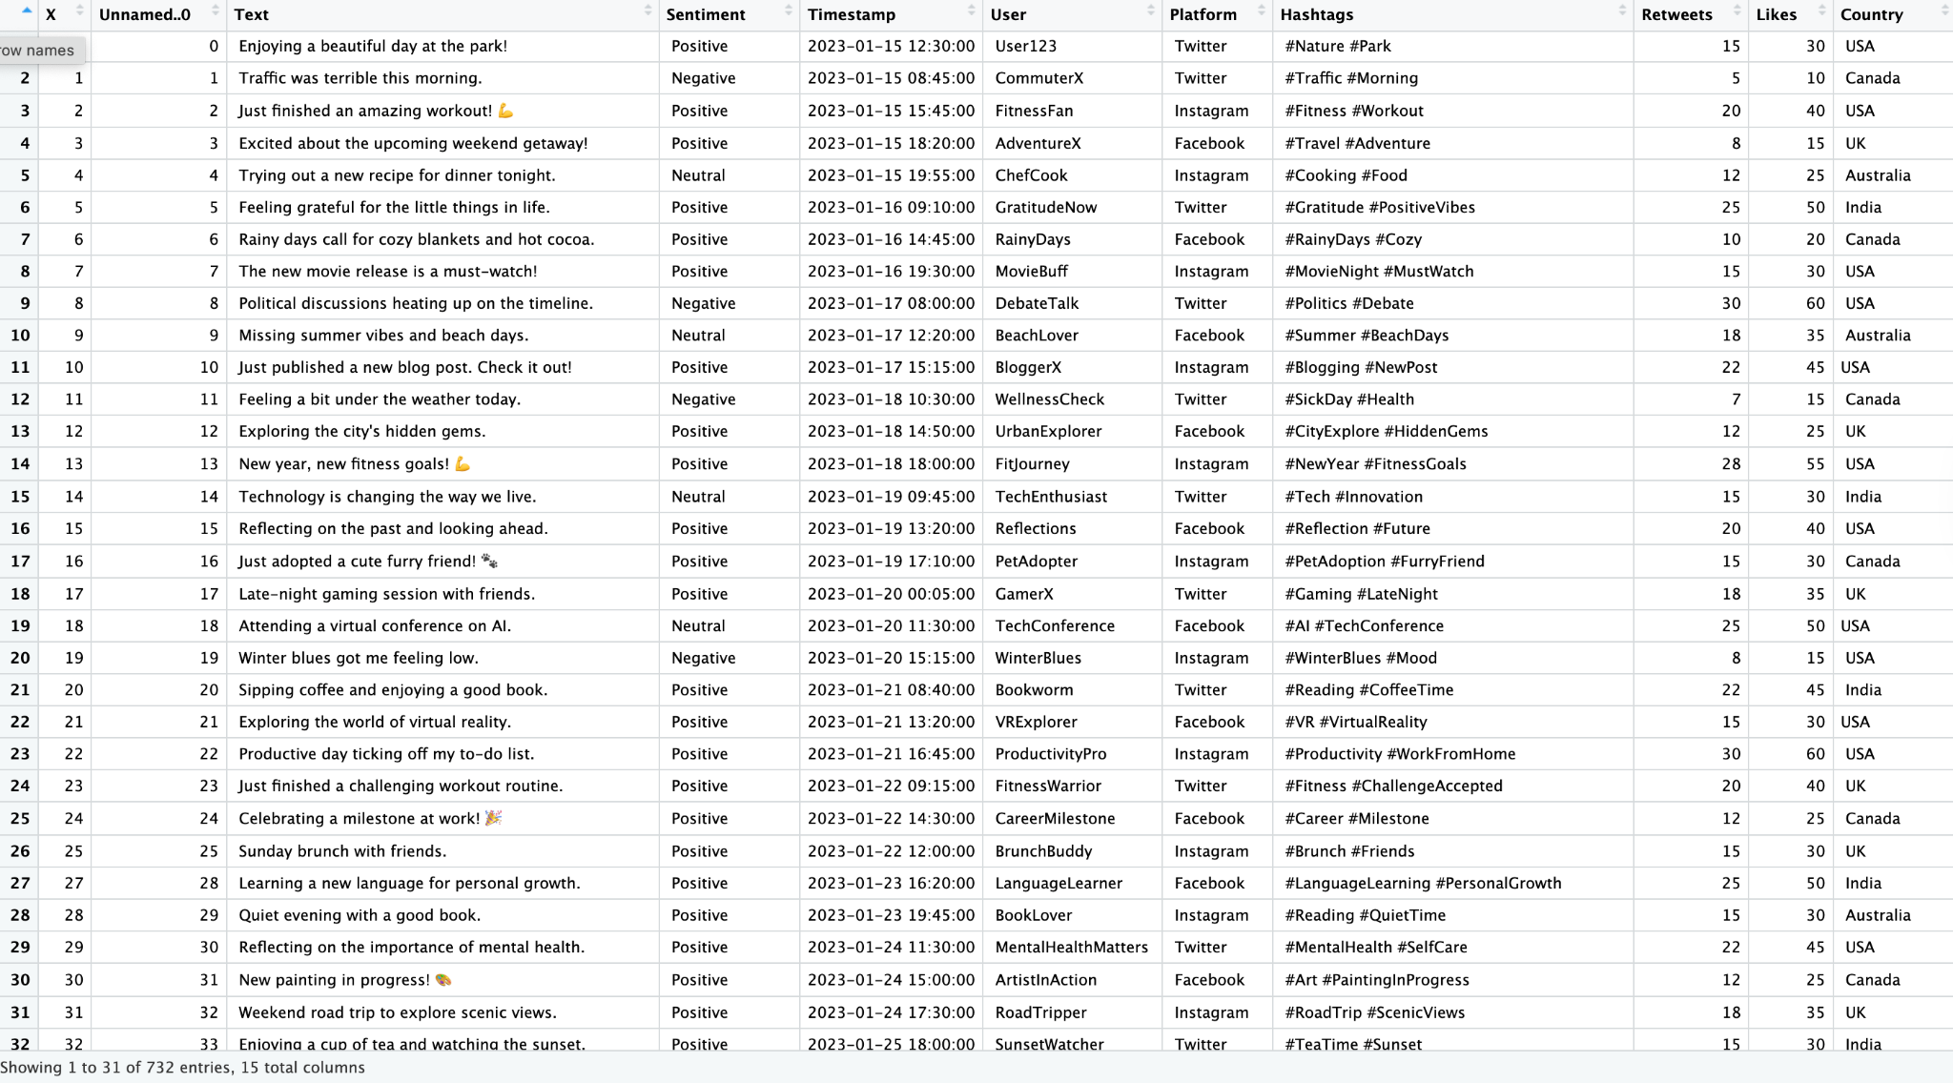
Dataset2: sentimentdataset.csv

Slide 8
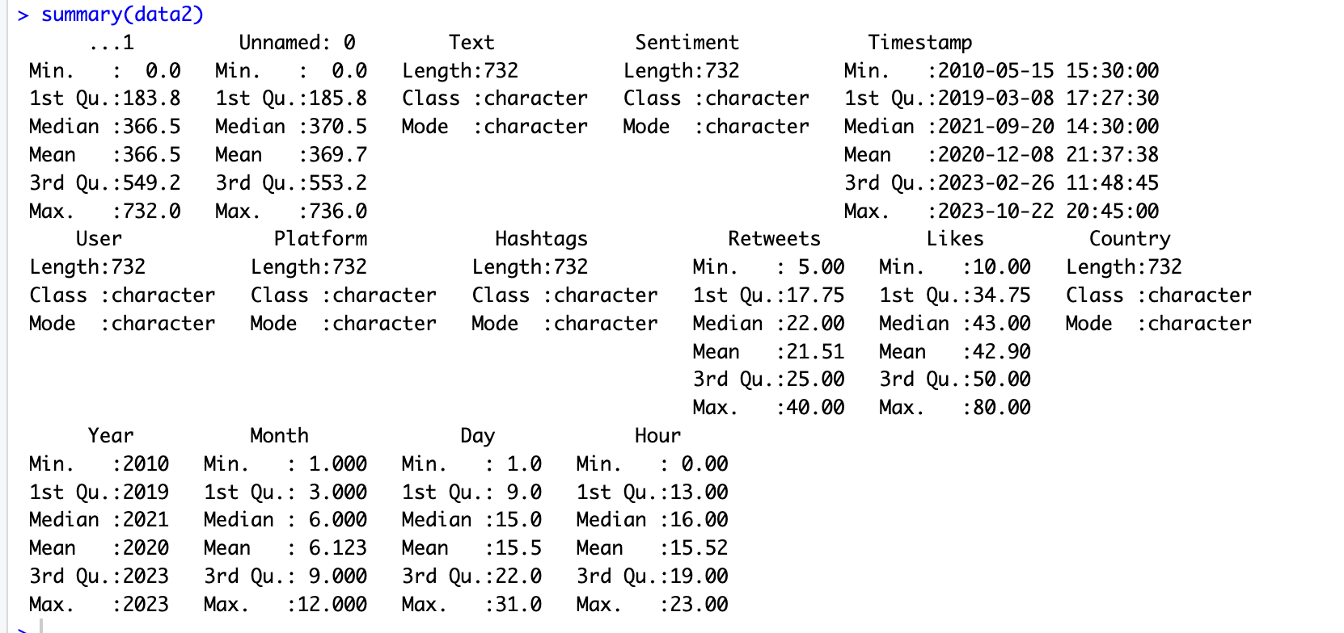
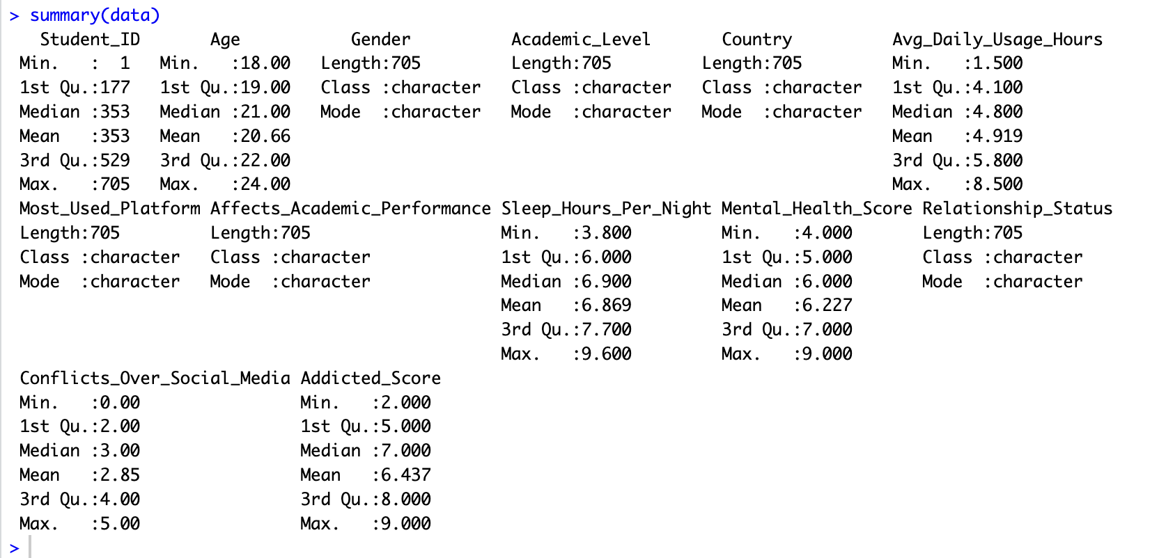
Summary
Dataset 1
Dataset2

Slide 9

Question?
How many hours per day do YOU think the average student spends on social media?
• Less than 3 hours
• Between 3–6 hours
• More than 6 hours

Slide 10
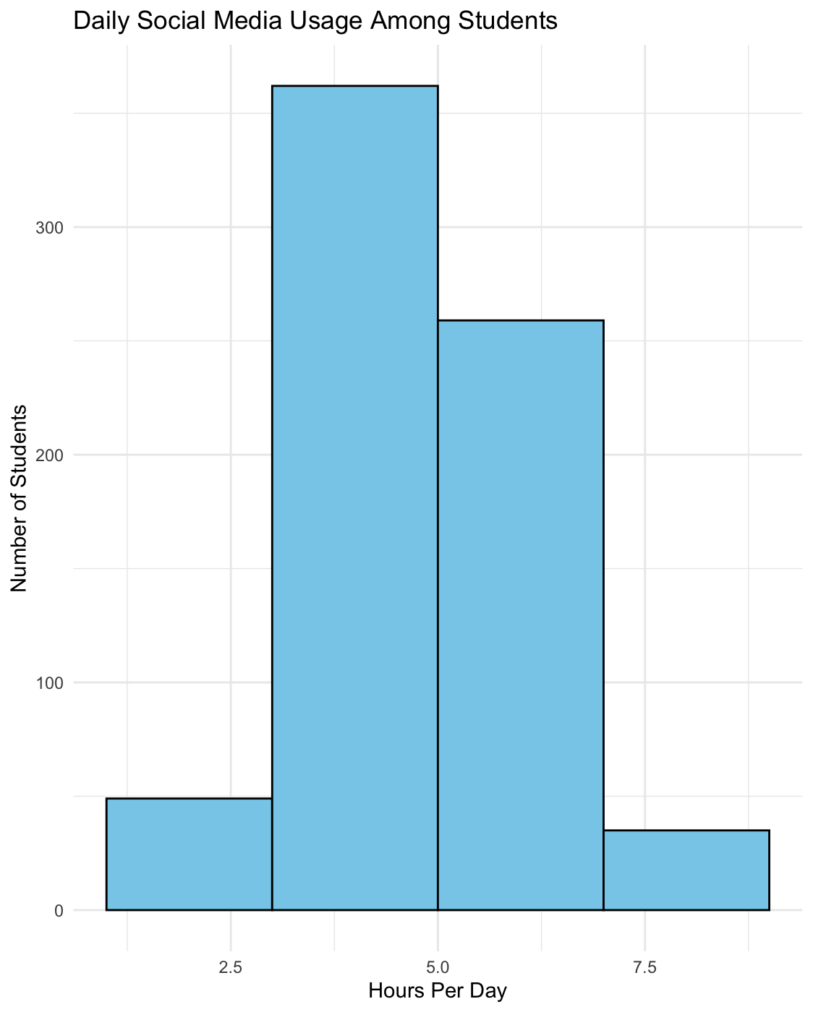

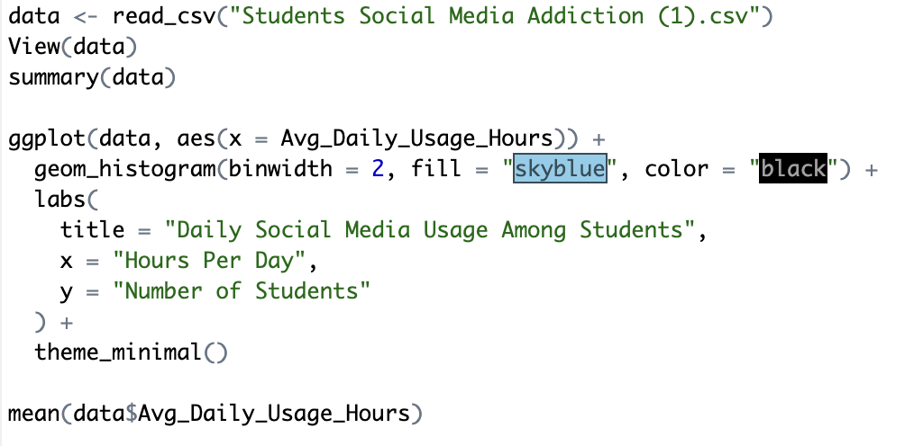
Answer + Code

Slide 11
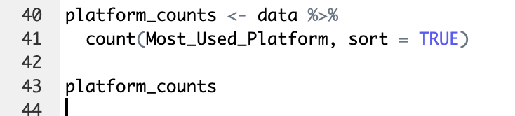
Code
To answer our second research question, we used R to count how many students reported each platform as their “Most Used.” This allowed us to visualize overall social media preferences.

Slide 12
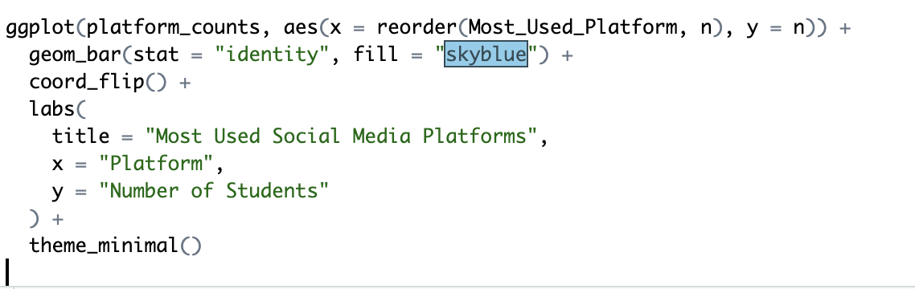
Code
Visualizing Platform Popularity
We used a bar chart to highlight which platforms dominate student daily use. This method makes it easy to compare engagement across Instagram, TikTok, YouTube, and others.

Slide 13
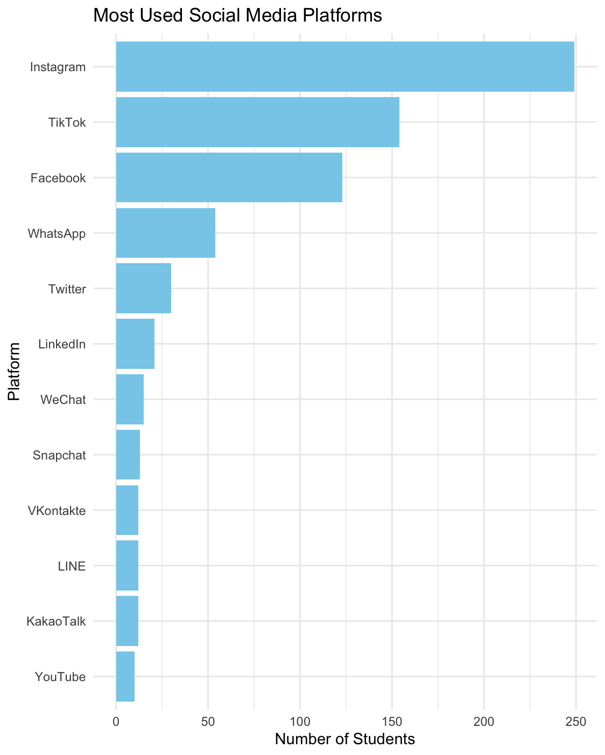
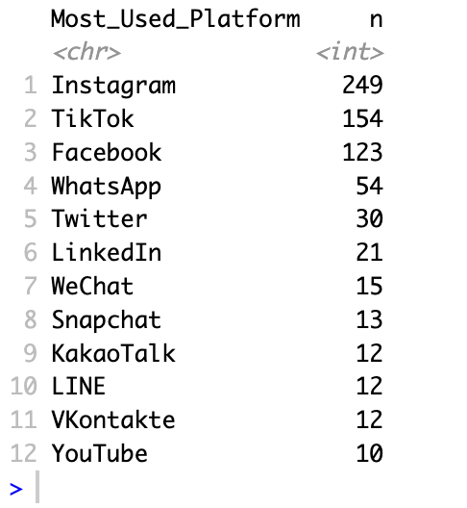
Data Findings
Instagram alone had 249 students listing it as their primary platform, meaning it outperformed TikTok by almost 100 users.
The top three platforms (Instagram, TikTok, Facebook) together account for over 70% of all student preference, showing that addictive, scroll-based apps dominate student attention.
Lower-use platforms like LinkedIn and Snapchat fall well behind, suggesting students prioritize entertainment and communication over professional networking.

Slide 14
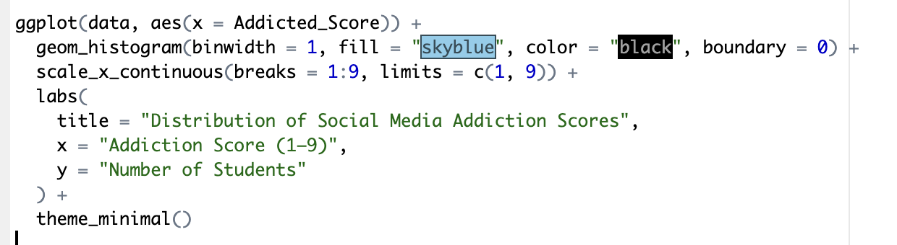
Code
To answer our third research question, we used R to analyze the students self reported data scores of what their addiction levels were. This code allowed us to visualize a Histogram of Addiction Score.

Slide 15
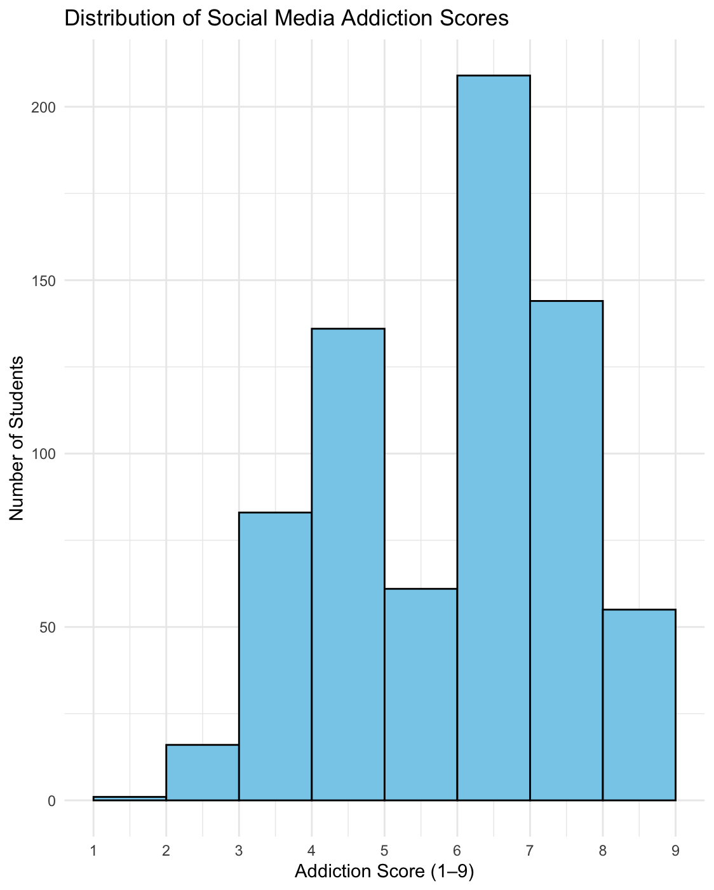
Data Findings
The distribution is strongly left-skewed, meaning a very small number of students rated their addiction low, while the majority rated themselves highly addicted.”
Over half the class gave themselves scores between 7 and 9, meaning students are self-aware of addictive behaviors, not unaware.
This indicates that high usage is not accidental or purely circumstantial, students recognize their dependence on social platforms.

Slide 16
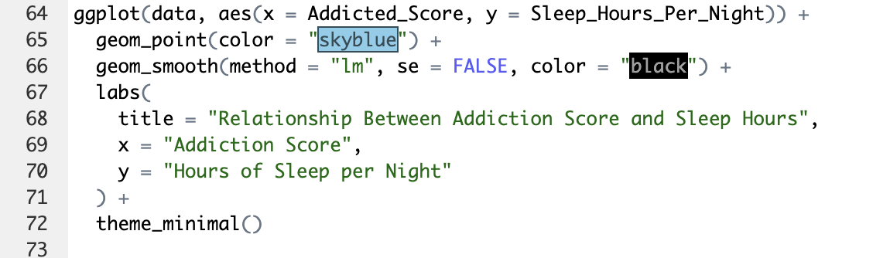
Further Insight Code
Now that we know that students are posting higher addiction scores lets see how that correlates to sleep.

Slide 17
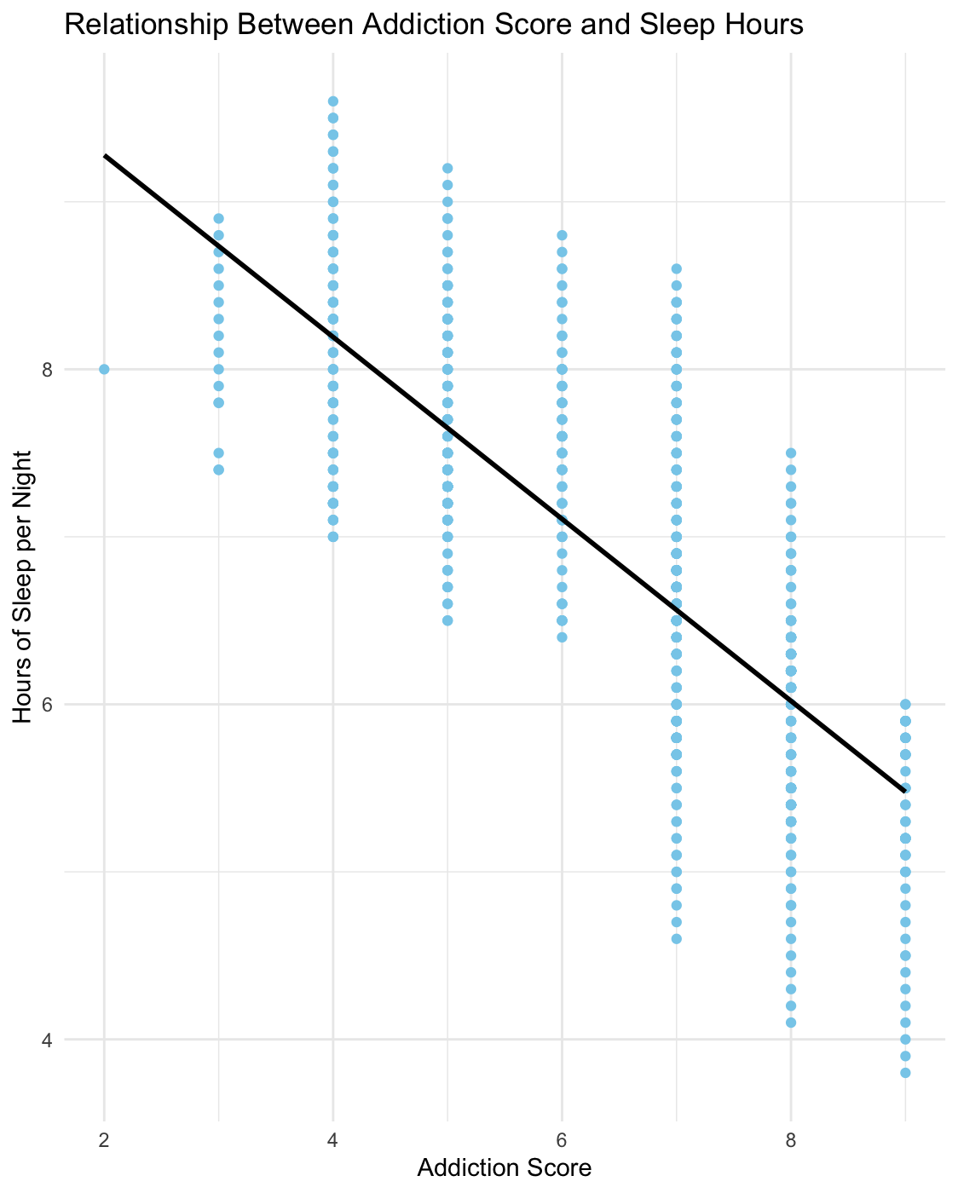
Data Findings
There is a noticeable negative correlation between addiction score and sleep hours, students with higher addiction scores tend to sleep less.
Although the trend line is downward overall, we also observed at least one major outlier, suggesting some students maintain high usage without sacrificing sleep but this is rare.
The general pattern supports research that social media can interfere with healthy sleep routines due to nighttime scrolling or emotional stimulation.

Slide 18
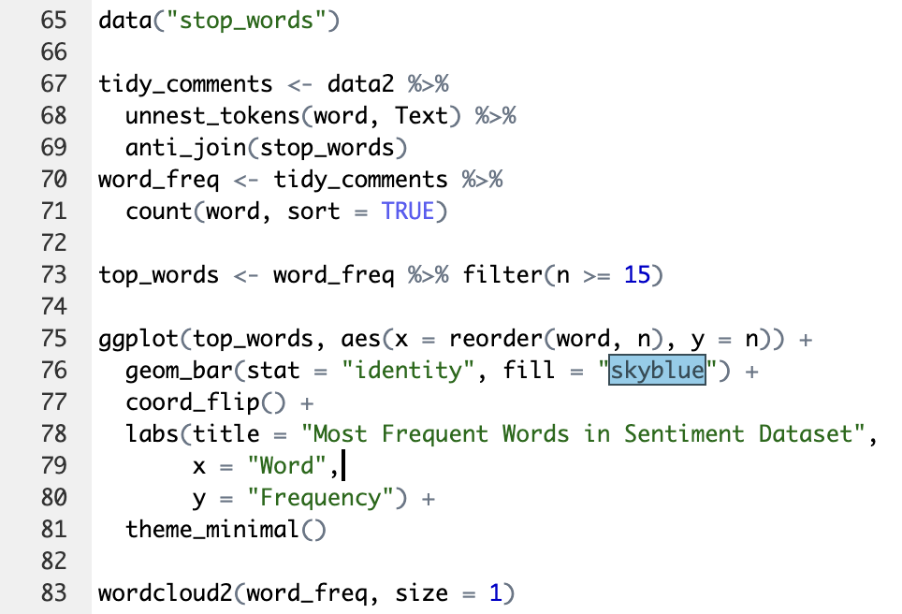
Sentiment Code
Next we took our sentimentdataset.csv dataset and analyzed the text of random social media post from various platforms to gauge an idea of what these students could possibly be viewing, more negative or more positive information. First we cleaned, tokenized, then found the most common words in the posts via word cloud/barchart.

Slide 19
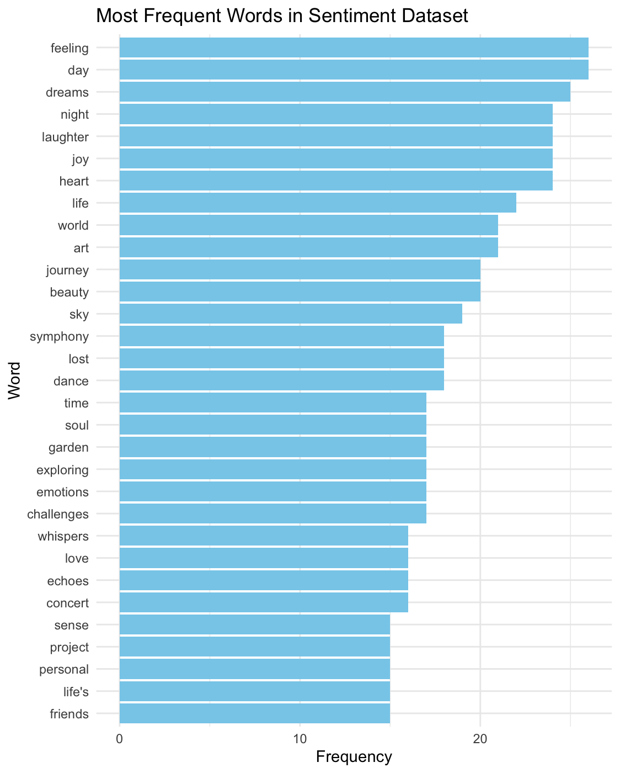
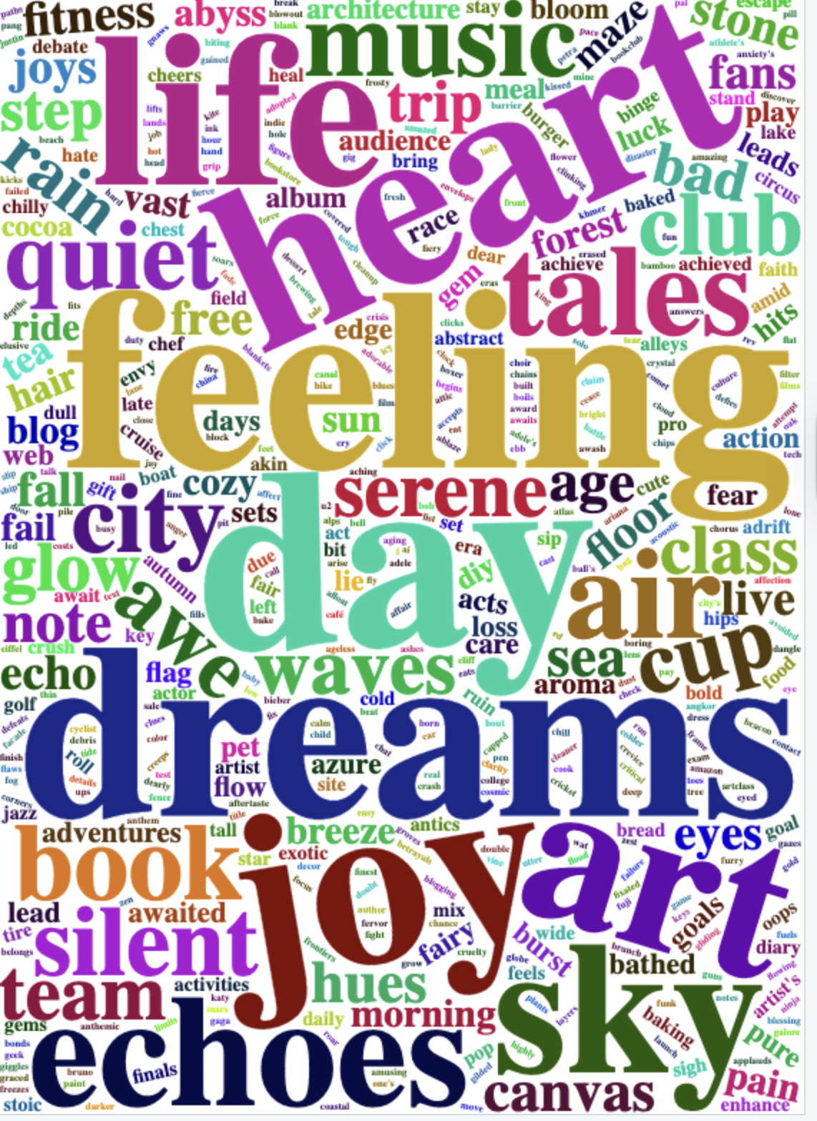
Data Findings

Slide 20
Data Findings
The word cloud reveals many emotionally charged terms like life, heart, feeling, dreams, etc. which indicates the content students see online often carries emotional weight.
Since emotional content increases engagement, this helps explain why students spend long periods scrolling; platforms prioritize posts that produce reactions.
This provides a behavioral explanation for why we see higher addiction scores, students are consuming content designed to trigger emotional responses.

Slide 21
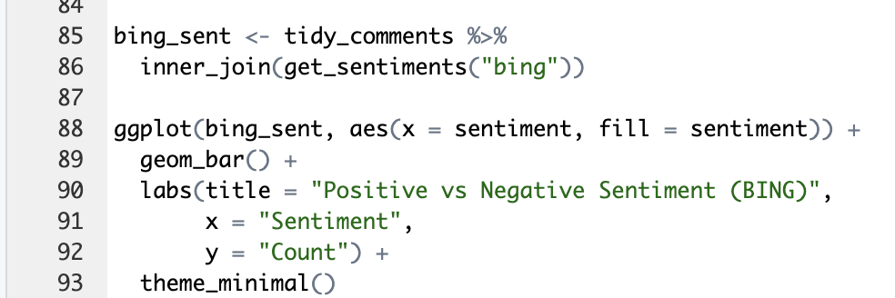
Further Insight Code
Finally we used bing sentiment to easier visualize what amount of the text on social media were negative/positive.

Slide 22
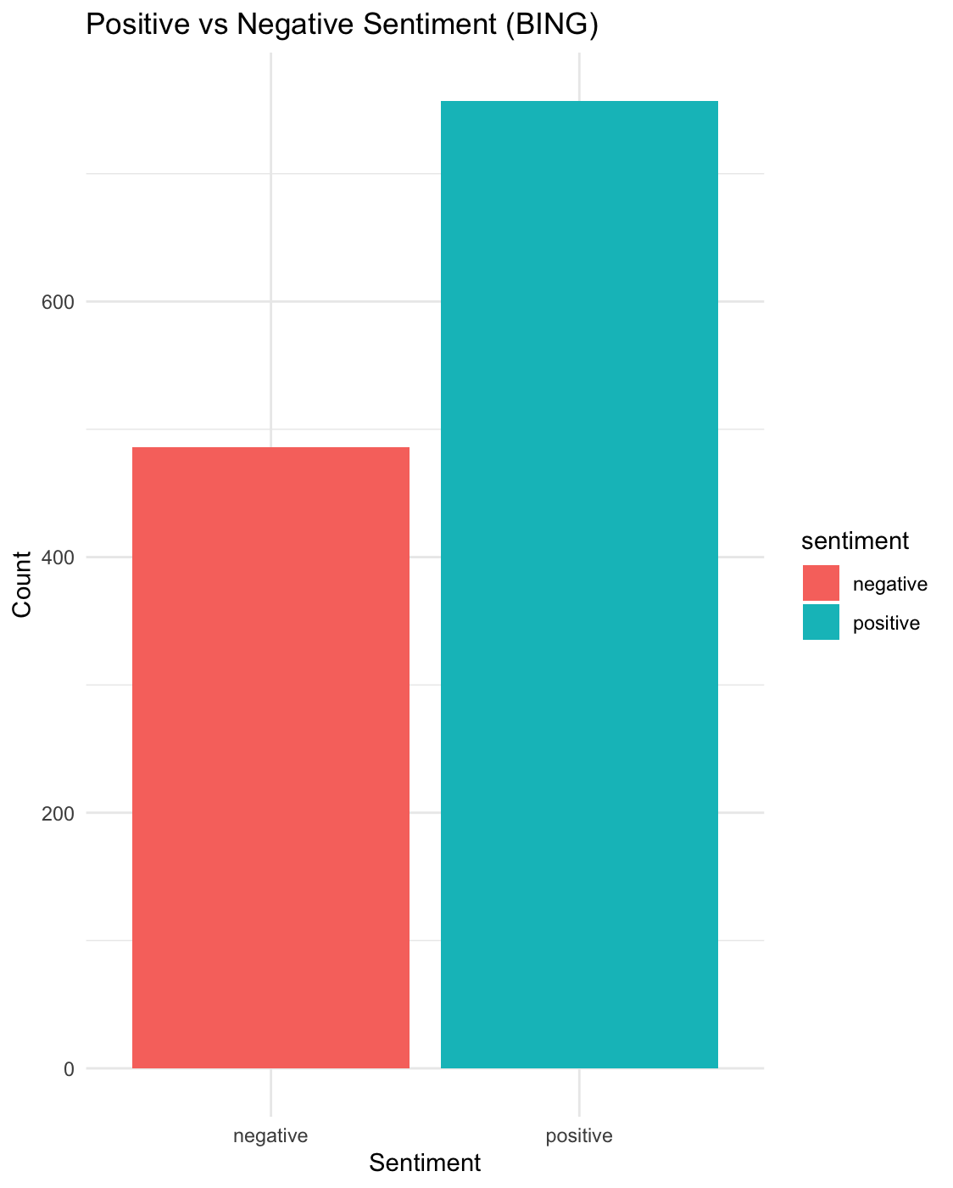
Further Insight Finding
Negative words appear frequently, suggesting exposure to stress-related or emotionally heavy content.
Positive words are also present, showing that social media provides entertainment, humor, and connection.
Combined, this reflects the mixed emotional environment students experience online.

Slide 23
Further Insight
How Sentiment Relates to Students’ Social Media Addiction:
Students who spend more hours online are likely consuming content with emotional spikes (both positive and negative).
High emotional content is known to increase engagement and time spent on platforms.
This aligns with our data showing that heavier users tend to have higher Addicted Score values.
The sentiment dataset helps explain why students stay online longer, emotionally charged content is more addictive.

Slide 24
Conclusion
Students spend nearly 5 hours per day on social media, showing extremely high engagement.
Instagram, TikTok, and YouTube dominate usage and align with patterns linked to addictive scrolling.
Addiction scores reveal that many students fall into moderate–high addiction categories.
Sentiment analysis shows students often view emotionally intense or negative content, reinforcing compulsive habits.
Together, both datasets show that student behavior is shaped by heavy usage, emotional content, and developing signs of addiction, which may also contribute to reduced sleep and lower daily productivity.
Overall, the findings suggest a need for greater awareness and healthier digital habits among students.

